Slide 1



PRESTIGE PRIME BANK
Elevating Excellence In Banking
Batch-1, Team-5

Slide 2
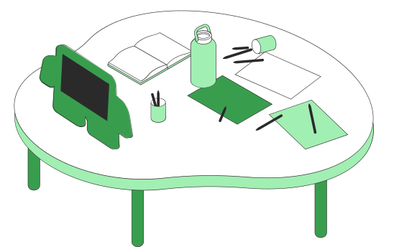
Overview
Aims to provide users a secure and convenient platform for remote financial management.
Developed using Spring Boot, offering a range of features:
User Registration and Login
Account Overview
Fund Transfer
Account Statement Generation
Password Change
Account Settings
Deposit and Withdrawal
Transaction History
Admin Dashboard
Secure Logout

Slide 3


Key Features
User Benefits
Convenience: Manage accounts remotely, anytime, anywhere.
Efficient Transactions: Secure fund transfers, bill payments, and more.
Comprehensive Reports: Stay updated on financial activities.
User-Friendly Interface: Simplified platform for easy navigation.
Secure Operations: Carry out financial transactions securely.
Spring Boot Power: Scalability, reliability, and easy integration with databases and third-party services.
Email Service: push notification at the time of account creation and password change
Enhanced User Experience: Intuitive interfaces and streamlined workflows.
Security Focus: Robust authentication, encryption, and protection against vulnerabilities.

Slide 4


Growth
Scalability : ensures that the system's architecture handles increased user load, ensuring that it remains responsive and reliable even as user numbers grow
Feature Expansion : Continuously enhancing the system's functionalities based on user feedback and emerging market trends, offering new services that cater to evolving financial needs.
Customer Satisfaction
Ensure a high level of customer satisfaction by prioritizing user experience and addressing their needs effectively:

Slide 5
USER CHARACTERISTICS
Customer | Admin
register and login to portal check his balance check transaction history add beneficiary send money to account/beneficiary | validate and create customer account delete customer account change the bank branch edit customer details add money to customer account

Slide 6










TECH STACK
FRONT-END
BACK-END
DATABASE
LANGUAGES
IDE
TESTING

Slide 7






REpresentational State Transfer
GET | POST | PUT | DELETE
HTTP Request
JSON | XML | HTML
HTTP Response
GET
POST
PUT
DELETE
Client
REST API
Server

Slide 8

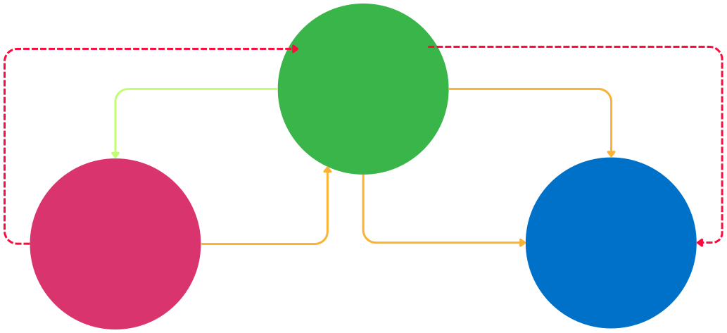
Model · View · Controller
pulls data via getters
pulls data via getters
Controller
iniates
Brain
modifies
controls and decides how data is displayed
View
Model
UI
Data
Represents current model state
updates data via setters and event handlers
sets data via setters
Data Logic

Slide 9









Request
Customer
Customer API
Check Login
Admin API
Admin
Response

Slide 10
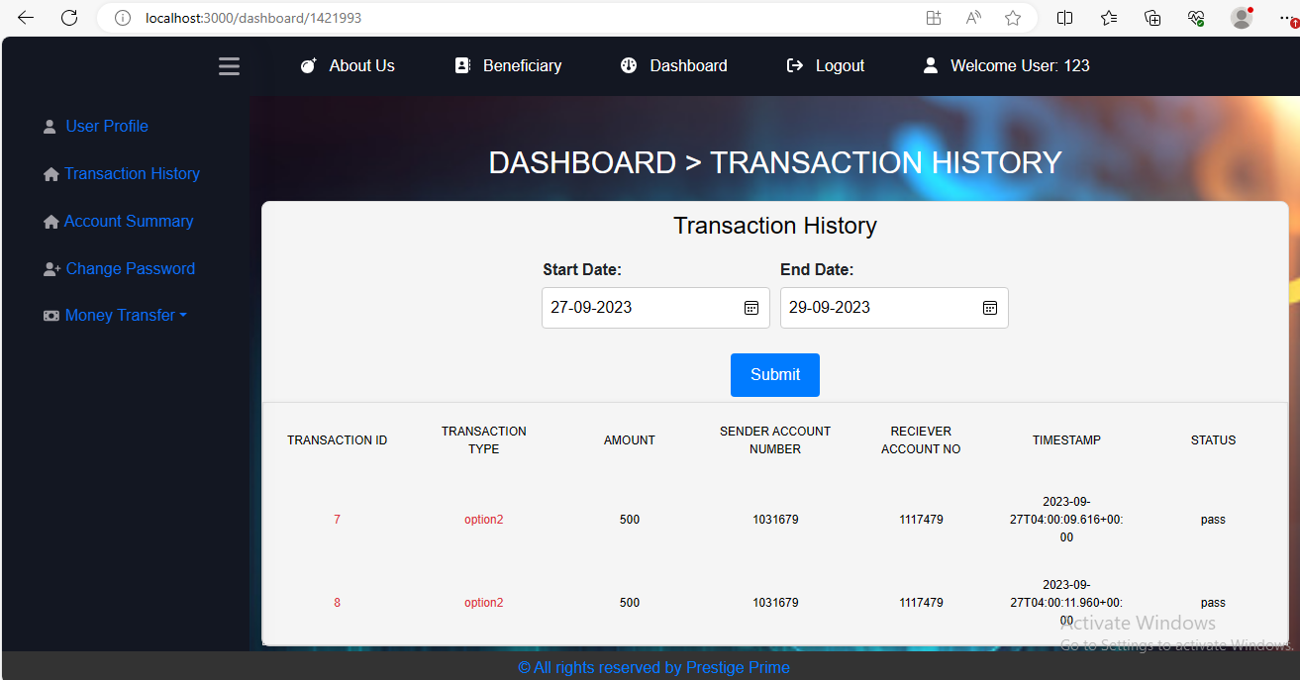
CUSTOMER DASHBOAD

Slide 11
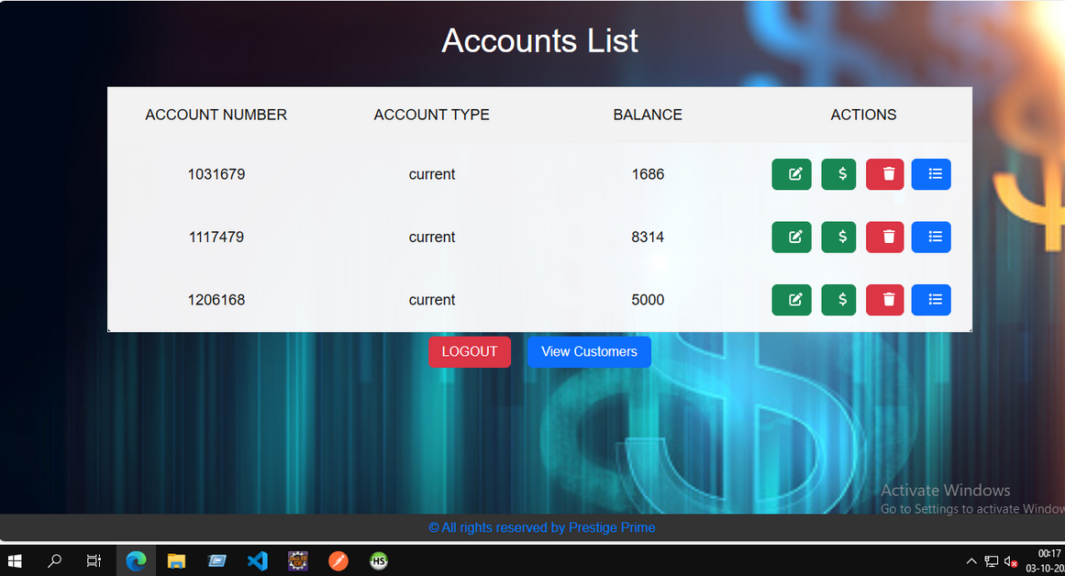
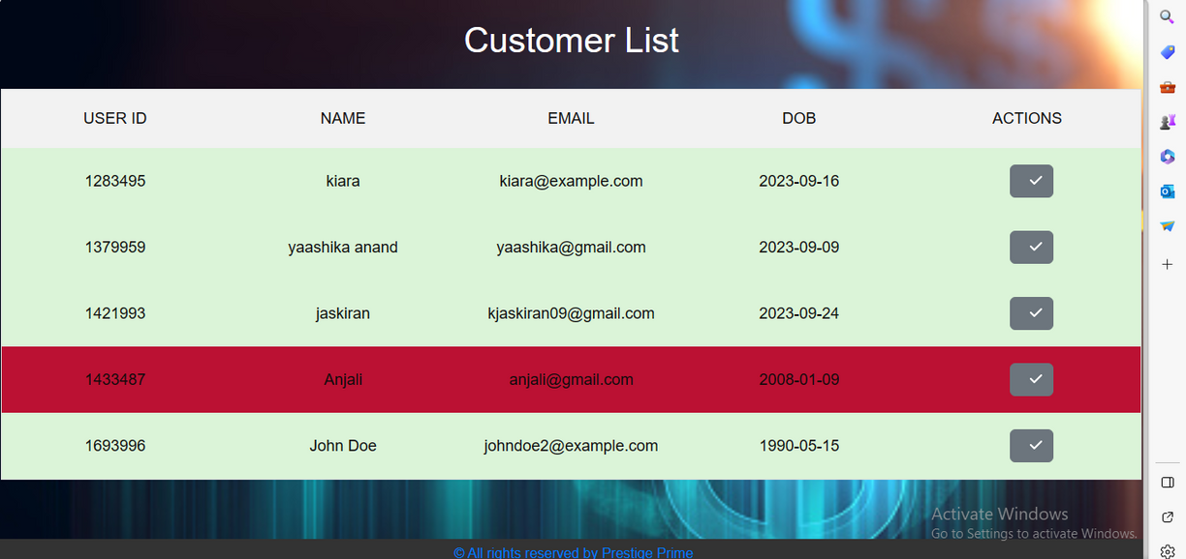
ADMIN DASHBOARD

Slide 12
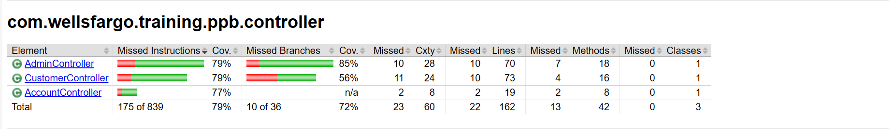

UNIT TEST COVERAGE

Slide 13










GET
/create-customer
GET
/accounts
GET
/get-beneficiary/{customer-id}
GET
/accounts/{account-no}
POST
/login
GET
/accounts/{account-no}/transactions-between-dates
PUT
/{customer-id}
Account
GET
/accounts/{account-no}/transactions-between-dates
POST
/transact
DEL
/accounts/{id}
Customer
POST
/requestchangepass
GET
/changepassword
POST
POST
/login
GET
/add-beneficiary/{customer-id}
POST
GET
/{admin-id}/accounts
POST
/{admin-id}/logout
DEL
/{admin-id}/deletecustomer/{cust-id}
PUT
/{admin-id}/accounts/{accid}
Admin
PUT
/{admin-id}/addmoney/{accid}
DEL
{admin-id}/accounts/{account-id}
PUT
/{admin-id}/validate-customer

Slide 14



CHALLENGES
Learning Curve
Integration Complexity Debugging in case of failures Testing and QA
Version Control
Error Handling
Continuous Learning
Time Management

Slide 15











Biometric Authentication
Voice and Gesture Commands
AI-Powered Customer Support
Predictive Analytics for Fraud Detection
IoT Integration
Blockchain and Cryptocurrency Integration

Slide 16




Divyanshi
Agrawal
Jaskiran Kaur
Jayant
Nigam
Kapil Kungwani
Swati
Jindal
Yaashika
Anand

Slide 17


